Slide 1
Digital Technology Merit Badge Troop 964 – 1/19/18

Slide 2
Digital Technology – Binary at its core
Binary is a designation of “two numbers”: Bi-nary
0 and 1 are the basis of computer language, essentially off and on
Computers interpret and translate complex binary strings into meaningful code, letters and numbers.
ASCII is the term referring to recognizable characters such as numbers, letters & symbols (A 5 #). These characters are equal to Binary groups of eight 1s and 0s per character
A in Binary is 010000001
5 in Binary is 00110101
# in Binary is 00100011

Slide 3
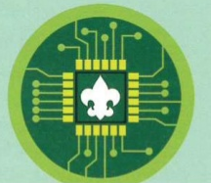
Digital Technology – Binary in a Badge
The original design for the Digital Technology merit badge contained a special ASCII encoding in Binary. However, due to constraints in the badge making process the idea was abandoned in the final design.
01000010 = B
01010011 = S
01000001 = A

Slide 4
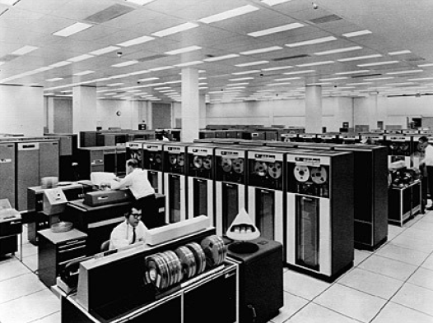
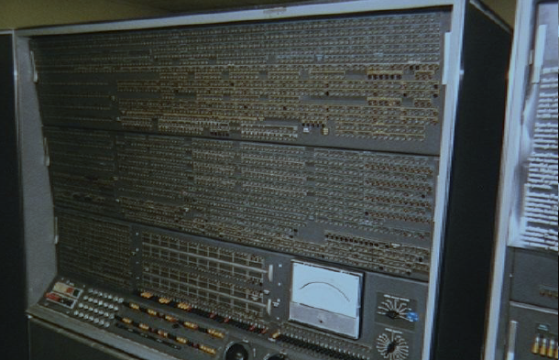
Digital Technology over time
2A
Your Grandparents Time (~1940s-1970s)
1945: ENIAC Unveiled
Colossus Mark 1 - 1944
1959: IBM Stretch
1970s: IBM Mainframes

Slide 5
Digital Technology over time
2A
Your Parents Time (~1980s-2000)
1991 – 2000: The Rise of the “Internet”
1982: Philips CD100
1981: IBM 5150
1985: Nintendo Entertainment System
1990: First HDTV Broadcast

Slide 6
Digital Technology over time
2A
Your Time (~2000s-Present)
Growth of Digital Storage Availability
Cellphone to Smartphone Revolution

Slide 7
Digital Technology over time
2A
Your Time (~2000s-Present)

Slide 8
Digital Technology over time
2B
The Future????

Slide 9
Digital Technology – Digital Files
3A
For digital storage, different types of data are digitized into different formats.
Text is digitized as ASCII
Digital Formats: txt, doc, ods, pdf
Sound is digitized as waves forms
Digital Formats: mp3, wma, aiff, wav
Pictures are digitized as pixel patterns
Digital Formats: jpg, gif, png, tiff
Videos are digitized as frames and rates
Digital Formats: avi, mpeg, flv, mov

Slide 10
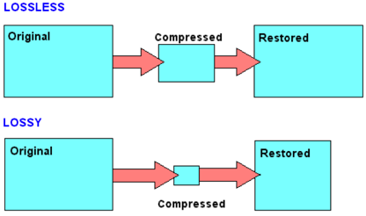
Digital Technology – Lossy vs Lossless
3B
Compression works on the principle of removing extraneous data to reduce the size of a digital file
Lossy means some of the original quality is removed to reduce the size. Cannot be restored. Examples: JPG, GIF, MP3
Lossless (“no Loss”) allows the “original” quality of the object to remain. Examples: WMA, PNG, WebP

Slide 11
Digital Technology – Programming
3C
Many devices can be made “better” with digital programming

Slide 12
Digital Technology Computers, Gaming Consoles & Mobile Devices
3D
Similarities: Processors Programs Connectivity
Sound Install Software Digital Storage
Display Internet Access Audio Input (Most)
Differences: Keyboard Portable Controllers
Multi-user Cellular Proprietary Media Expansion Restricted Apps Online platforms

Slide 13
Digital Technology – Computer Networks
3E
Home Network
Computers
Wireless Network
Gaming Systems
TV Systems
Mobile Devices
Internet
A computer network is a group of computer systems and network devices interconnected to allow access to shared resources, such as printers and the Internet.

Slide 14
Digital Technology – Computer Networks
3E
Business Network
Computers
Servers
Hubs
Firewall
Router
Internet

Slide 15
Digital Technology Software, Programs and Apps
4A
Series of commands or set of instructions for a processor to complete a task:
Word Processing
Games
Utilities (calendar, calculator)
Photo/Video Editor

Slide 16
Digital Technology Software, Programs and Apps
4A
Software, programs and Apps are created by developers using specific code or script.
Examples of coding or programming languages are:

Slide 17
Digital Technology Software, Programs and Apps
4B
Apps you & your family use?

Slide 18
Digital Technology – Malware
4C
Malicious code in the form of:
Viruses
Worms
Trojan horses
Spyware
Adware
Scareware
Ransomware
Any software used to disrupt computer operation, gather sensitive information, or gain access to private computer systems
Defined by its malicious intent, acting for the interests of the malware owner, rather than the user

Slide 19
Digital Technology Protecting Against Malware
4C
Anti-Virus Programs
Anti-Malware Programs
Software and System Updates
Smart Internet Browsing

Slide 20
Digital Technology What is “the Internet”?
Global Interconnection of networks
Supports transmission of data in multitudes of formats
Supports the “World Wide Web”
Works on a principal of routing requests and responses

Slide 21
Digital Technology Connecting to the Internet
5A
Tablet obtains IP address from WiFi Router
WiFi Router is connected to Cable Modem
Cable Modem is connected to ISP
ISP routes traffic to and from the Internet

Slide 22
Digital Technology Connecting to the Internet
5A
Smartphone connects to a Cell tower
Cell Tower is connected to ISP/Carrier
ISP routes traffic to and from the Internet

Slide 23
Digital Technology The Internet Fiber Backbone
Optical cable and optical devices make todays internet work. Lasers and optical cable transmit data in a series of flashes, where on and off signify Binary data streams like Morse code on a telegraph line.

Slide 24
Digital Technology Searching the Internet
5B
As early as 1990 search engines have enabled computer users to search for information on the WWW
Early Search Engines:
Archie (First!)
Webcrawler
Infoseek
Altavista
Lycos
AskJeeves
How do they work?
Automated programs called Bots crawl websites and record what they find
Bots will follow links between websites to find more content
Systems review the “found” content and identify important words creating an “index”
When you search the engine looks up matches in the index and provides links to the content it knows about.

Slide 25
Digital Technology Searching the Internet
5B
Early and modern search engines enable powerful search capabilities by using logic:
Examples:
Campfire program - Match anything with campfire or program
Campfire +program - Matches those with both words only
“Campfire program” - Matches only when those words appear exactly
Campfire program –girlscouts - Matches both words withOUT “girlscouts”
Other powerful capabilities are to search for video, image and shopping results

Slide 26
Digital Technology HTTPS – Secure Browsing
5C
HTTPS is the secured “protocol” used to protect web browsing content on the internet.
Principles of HTTPS:
Uses encryption between the sender and receiver
Allows for the sender to “verify” the receiver before sending sensitive data
Supports ability to ensure data wasn’t tampered with
Symmetric Cryptography
Asymmetric Cryptography

Slide 27
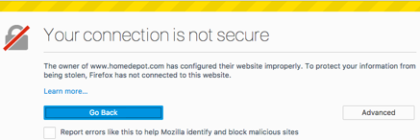
Digital Technology HTTPS – Secure Browsing
5C
Modern internet browsing uses an extensive process to try and protect internet users through HTTPS.
When visiting a site over HTTPS browsers will display a lock icon or say “Secure”
This means that the browser has checked the certificate of the website and has completed a secure connection using HTTPS and the websites certificate. Modern internet browsers will also warn you if there is an issue with a certificate

Slide 28
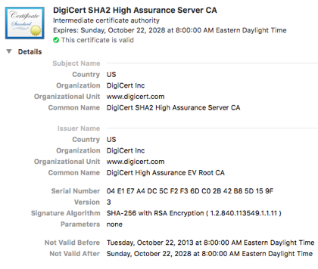
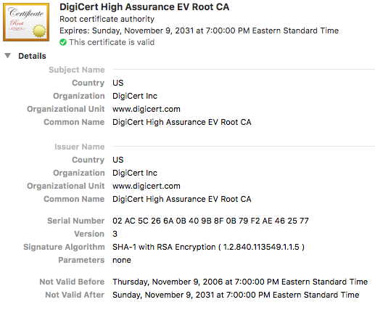
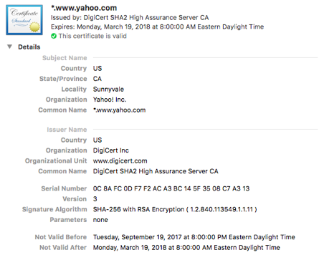
Digital Technology HTTPS – Secure Browsing
5C
Website certificates help browsers identify and validate secure websites.

Slide 29
Digital Technology Copyrights
7A
A Copyright is a legal right created by the law of a country, that grants the creator of an original work exclusive rights to its use and distribution, usually for a limited time, with the intention of enabling the creator to receive compensation for their intellectual effort.
What they do
Provides legal protection for the use and distribution of an original work
Why they exist
Encourages original work to be created with the intent it is protected and can be profitable to the creator

Slide 30
Digital Technology Patents
7A
A Patent is a set of exclusive rights granted by a sovereign state to an inventor or assignee for a limited period of time in exchange for detailed public disclosure of an invention.
What they do
Provides protection to the inventor of a solution
product or process as the owner
Why they exist
Identifies ownership of a solution, product or
process while publicly recording the solution.

Slide 31
Digital Technology Trademarks
7A
A Trademark is a recognizable sign, design or expression which identifies products, services or a company from those of others. Trademark owners can be individuals, business organizations or any legal entity. Trademarks can be located on packaging, labels, print media or even verbal phrases.
What they do
Provides protection of a unique design or expression to its creator or owner
Why they exist
Protects the owner from misuse or impersonation and creates an identity

Slide 32
Digital Technology Trade Secrets
7A
A Trade Secret is an invented formula, practice, process, design, instrument, pattern, commercial method or compilation of information which is not generally known or reasonably ascertained by others, and by which a business can obtain an economic advantage over competitors or customers.
What they do
Legally recognizes unique solutions as the property of the developer
Why they exist
Protects the solutions and methods of a developer from being forcibly
divulged while keeping products unique and safe.
Algorithm

Slide 33
Digital Technology Sharing Software with a friend?
7B
Software can be protected by copyright, trademark and patent laws. The defining difference in the software world is how the software is “Licensed”.
You can freely share software with your friend if it is Open Source licensed software.
Open source means that software is made available, including its source code, for distribution or modification.

Slide 34
Digital Technology Open Source vs. Proprietary
Open Source software can often be as capble, or more capable than proprietary software. Here are some examples of proprietary software and open source alternatives:
Proprietary Open Source

Slide 35
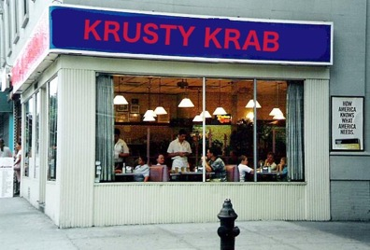
Digital Technology Trademark and Intellectual Property in the News
7C
Investors in a company named IJR applied for a trademark for a new restaurant. The trademark was for “Krusty Krab”
Viacom, owner of the SpongeBob brand, argued that while it did not have a trademark on “Krusty Krab” it was too distinctively tied to its intellectual property to be trademarked by IJR.

Slide 36
Digital Technology Proper Disposal
8A
Electronic devices are a complex mixture of many different materials. A single smartphone contains between 500 and 1,000 components. Many of these contain toxic heavy metals as well as hazardous chemicals and materials which do not decay.
Proper disposal of electronics protects the environment, humans and wildlife from exposure to dangerous and toxic materials that are in digital technology devices.

Slide 37
Digital Technology Proper Disposal
8A
Some dangerous chemicals used in electronic devices include:
Brominated Flame Retardants – used in circuit boards and casings. Long term exposure can lead to impaired learning and memory functions. It can also interfere with thyroid and estrogen hormone systems
Lead – Used in cathode ray tubes (CTR) in monitors. Exposure can cause intellectual impairment, and damage nervous, blood and reproductive systems.
Mercury – Used in lighting for flat screen displays. Can damage the brain and nervous system especially during early development
Hexavalent Chromium compounds – Used in metal housing production. Highly toxic and carcinogenic to humans and animals.
Polyvinyl Chloride (PVC) – Used in wire and cable insulation. Releases highly persistent and toxic fumes when burned.

Slide 38
Digital Technology Local Disposal Options
8B
Some local business support recycling of digital technology devices and batteries:
Turtle Wings is an R2 certified recycler of electronics:
To earn an R2 certification you must follow these steps:
Able to determine if technology can be reused or recycled
Able to test equipment prior to reuse
Able to repair equipment for reuse or resale
Able to separated non-reusable items into components
Steel, copper, aluminum, glass, plastic
Circuit boards, memory chips, power supplies
Able to reprocess components for remanufacturing
Reprocess components internally
Transfer components to reprocessors

Slide 39
Homework to complete the Merit Badge
Should already be completed:
4b – Name four apps or programs you or your family use. Describe how you each helps you or your family.
5b – Print ideas on how to conduct a Troop Court of Honor or Campfire Program from 3 different websites. Explain how you searched for them on the internet
Complete these over the next 2-3 weeks and bring in to Troop Meetings to confirm
6
Do 3 of 6a – 6h: Recommend b,c,e or f. Bring on a CD or DVD
9a or 9b
9a. Research 3 careers in Digital Technology, choose one and find out education, training and experience requirements. Explain why it interests you
9b. Visit a business or facility that uses digital technology. Describe four ways digital technology is in use. Share what you learned.

